Slide 1

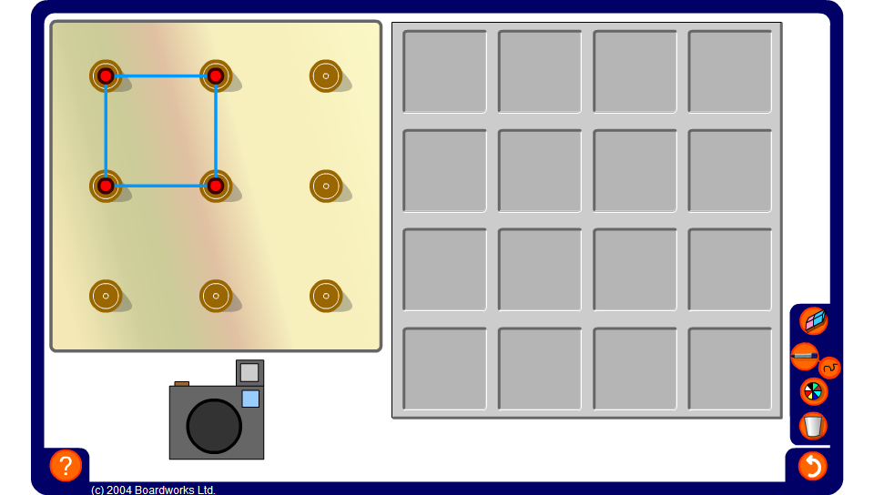


Quadrilaterals on a 3 by 3 pegboard
Notes:
Challenge pupils to find the 16 distinct quadrilaterals (not including reflections, rotations and translations) that can be made on a 3-by-3 pegboard.
Classify them according to their side, angle and symmetry properties.

